Slide 1
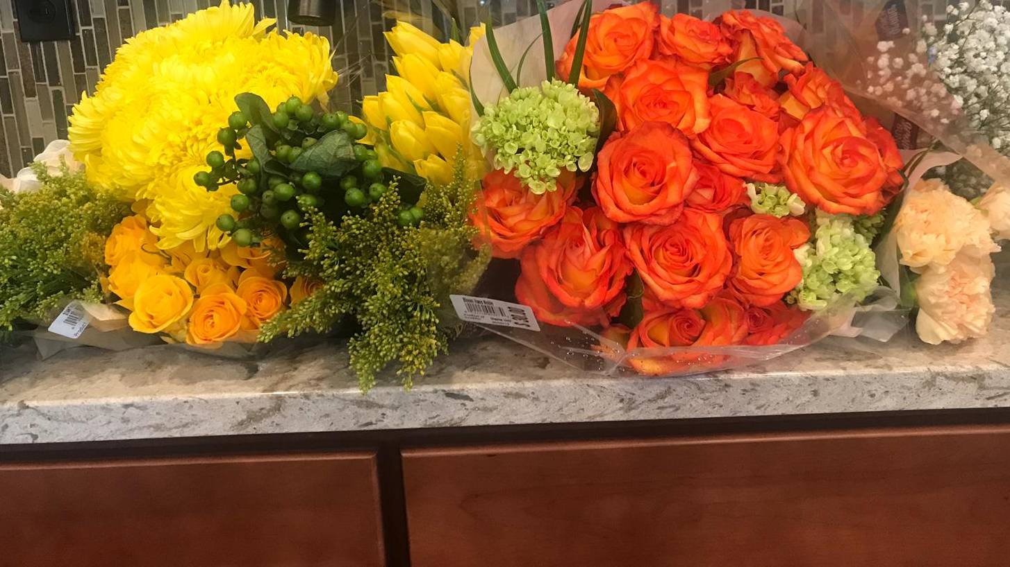
Flower Arranging with Lo
Mother’s Day 2019

Slide 2
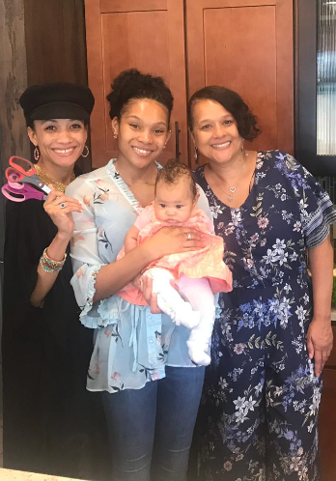
Hi there! My name is Lonisa Johnson and I am a florist in the Chicagoland Area. This year for Mother’s Day my dear husband encouraged me to teach and host a flower arranging class to celebrate my Mother and Baby Sister! Thankfully I took his advice. ☺
We spent quality time together and the inner fulfillment cannot be measured. It was such a good time! We played music, talked, and laughed – all while creating beauty!
In the pages to follow you will find an e-scrapbook of our time with blooms of love.
Enjoy.
- Lonisa

Slide 3
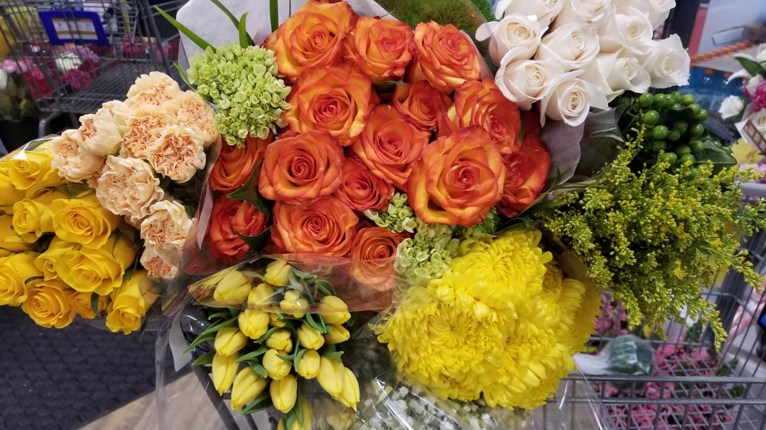
Mission: Secure the Flowers
A cart of overflowing cheery blooms!

Slide 4
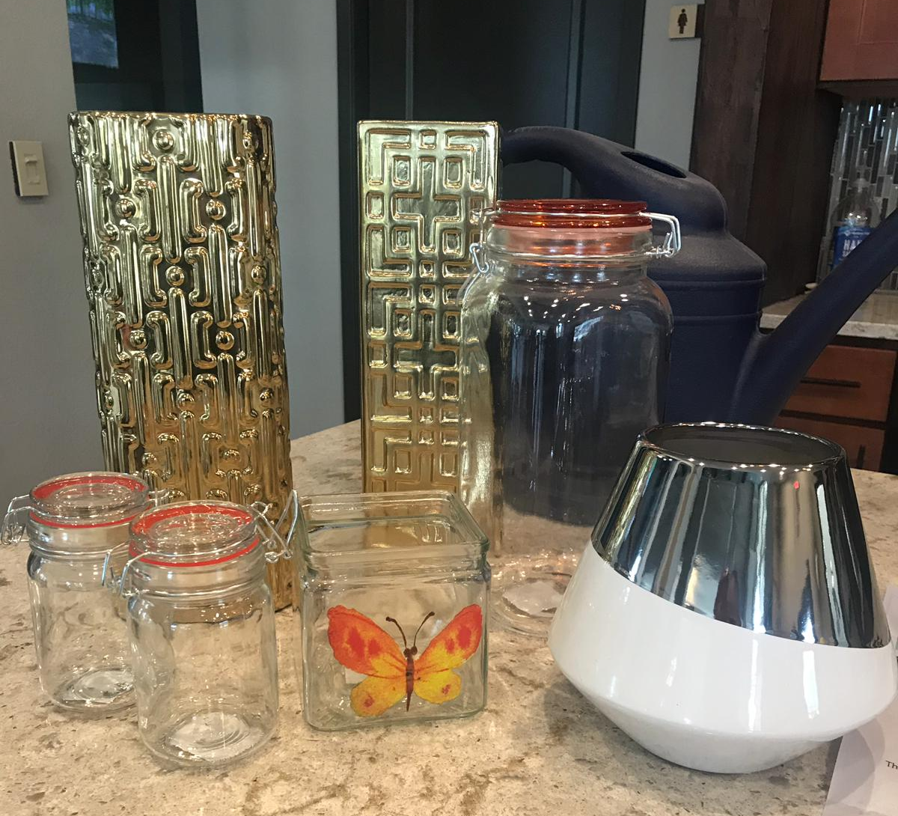
These snazzy vases were purchased from Family Dollar!
Fancy does not have to mean pricey!

Slide 5
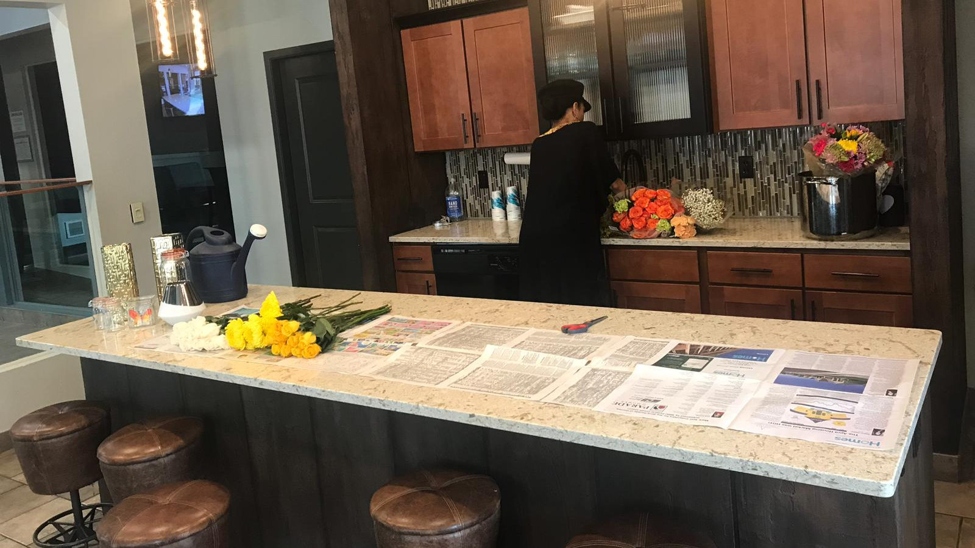
The Setup

Slide 6
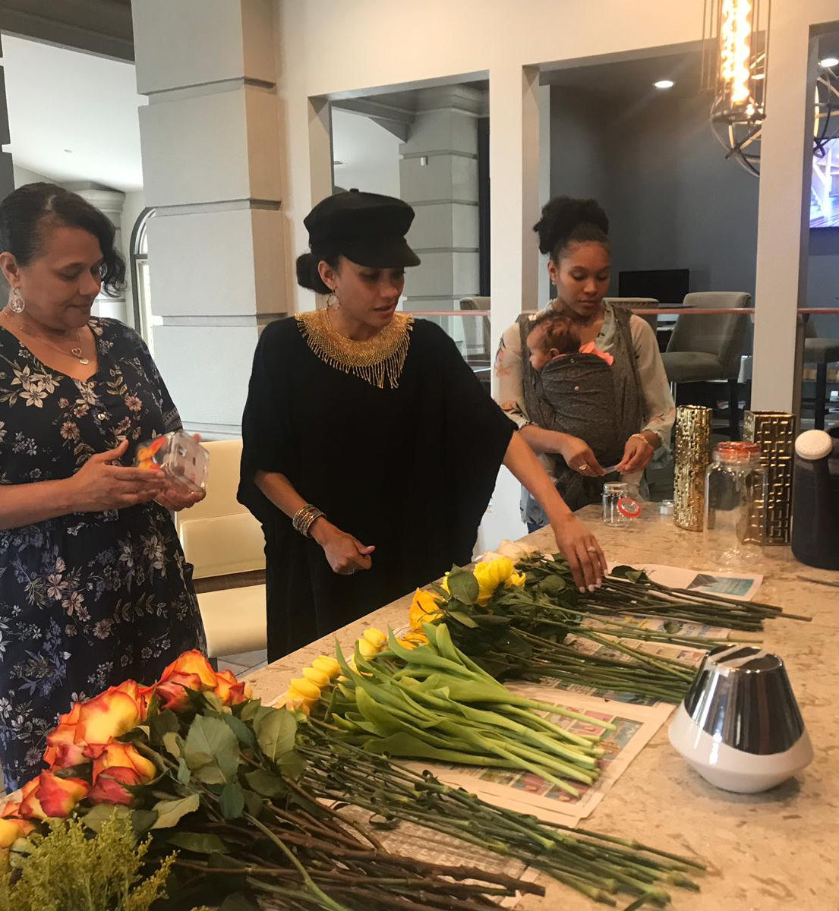
Assembly Line
When arranging it is incredibly helpful to have a clean and organized space. Lay out a cloth or newspaper for easy cleanup.
Grouping the flowers by color and type makes it easier to find what you are looking for and to see what is available for the arrangement.

Slide 7
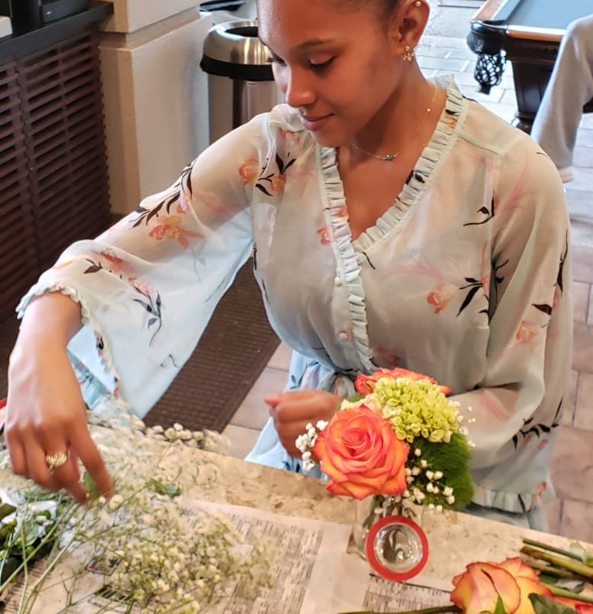
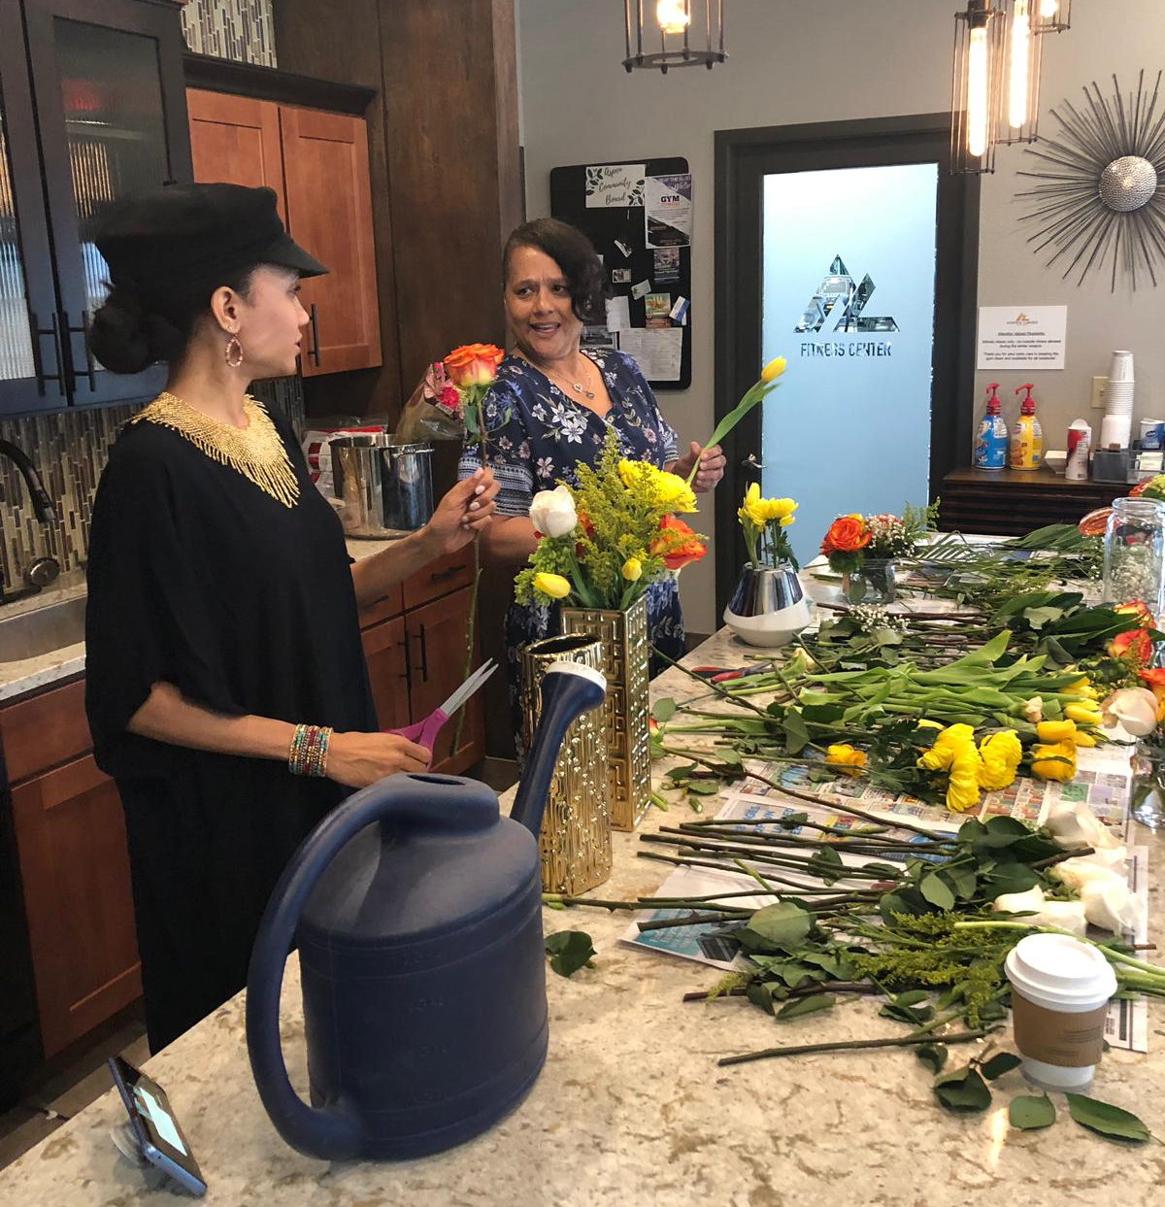
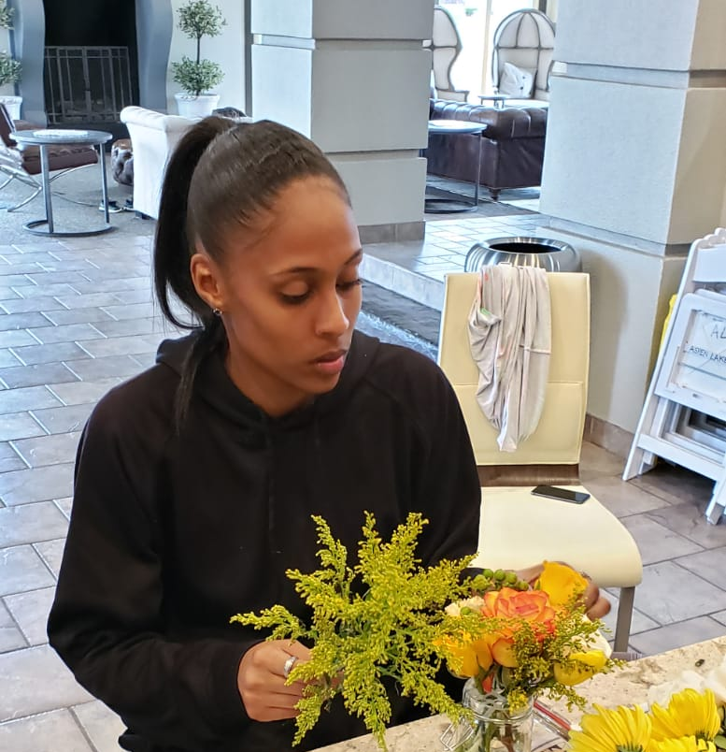
The Creation Zone

Slide 8
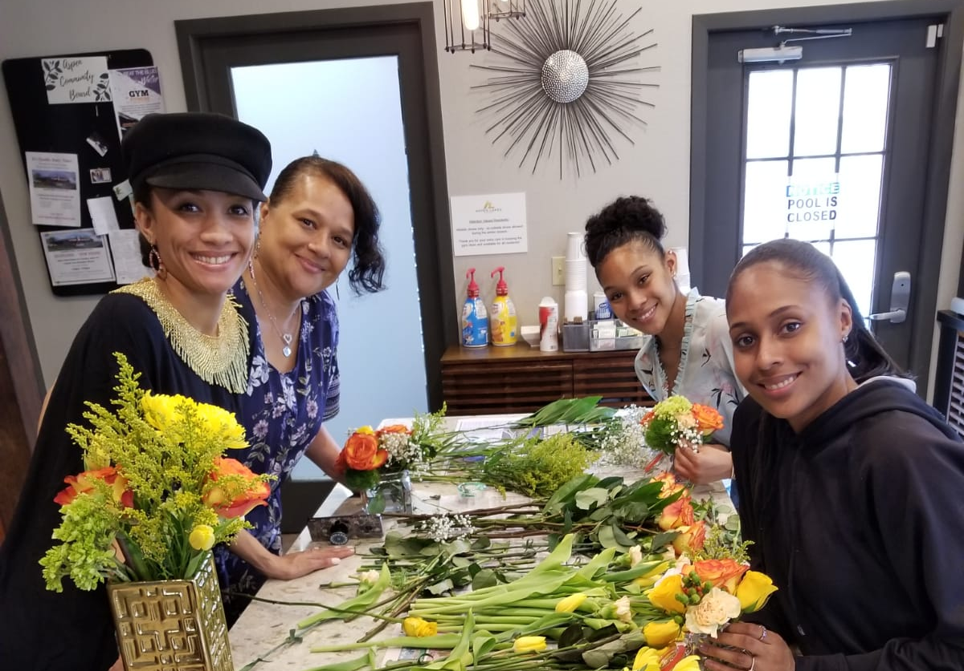
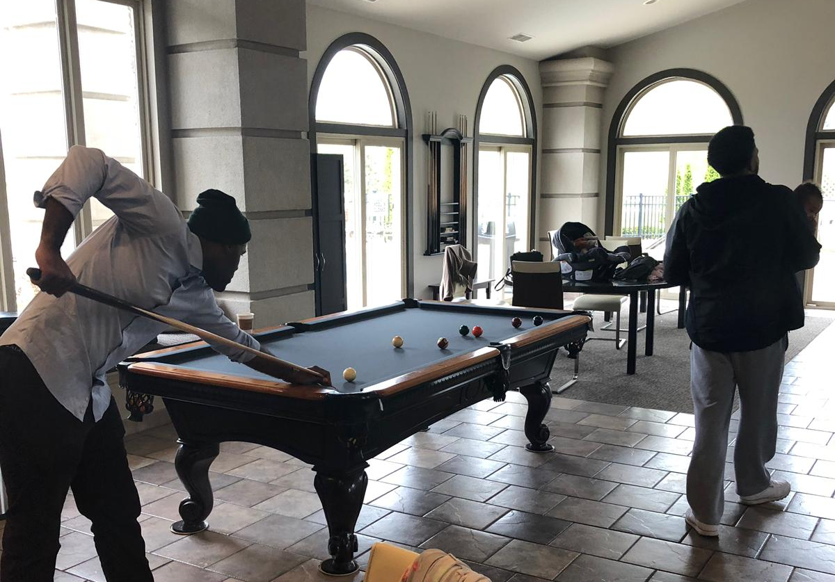
US
THEM ☺

Slide 9
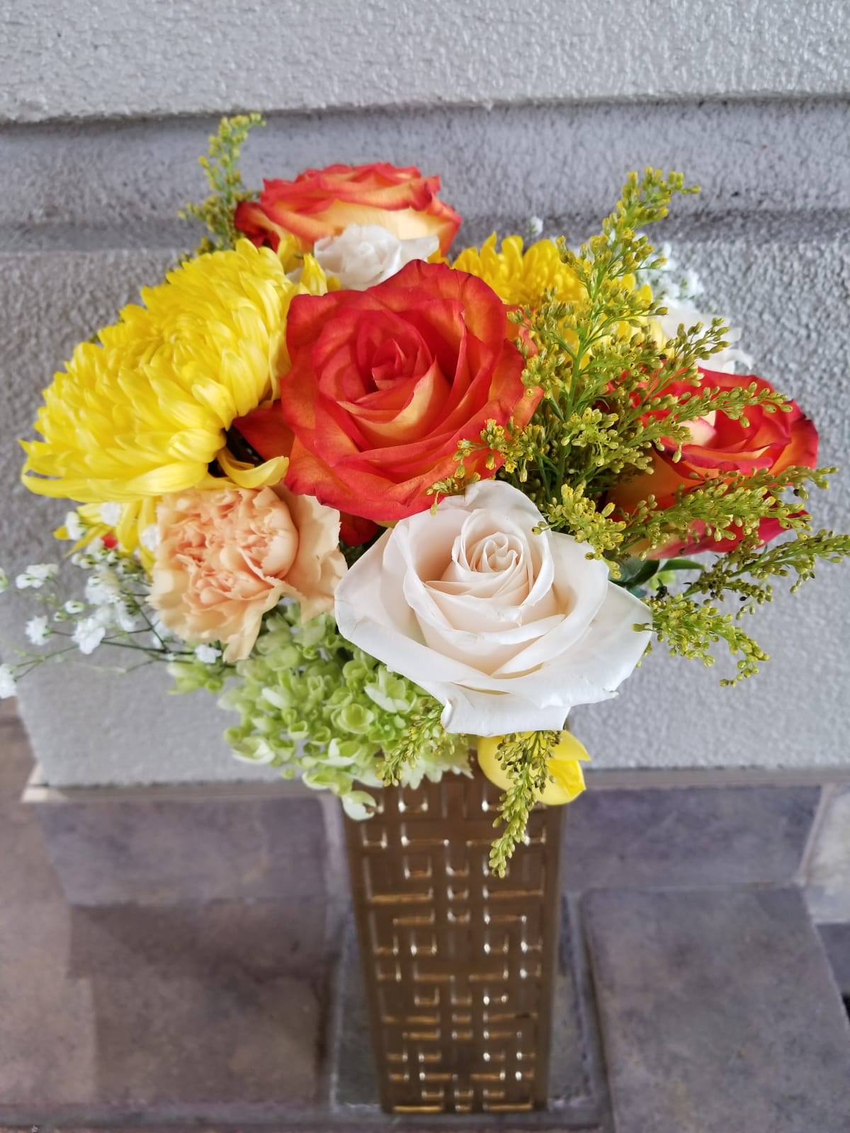
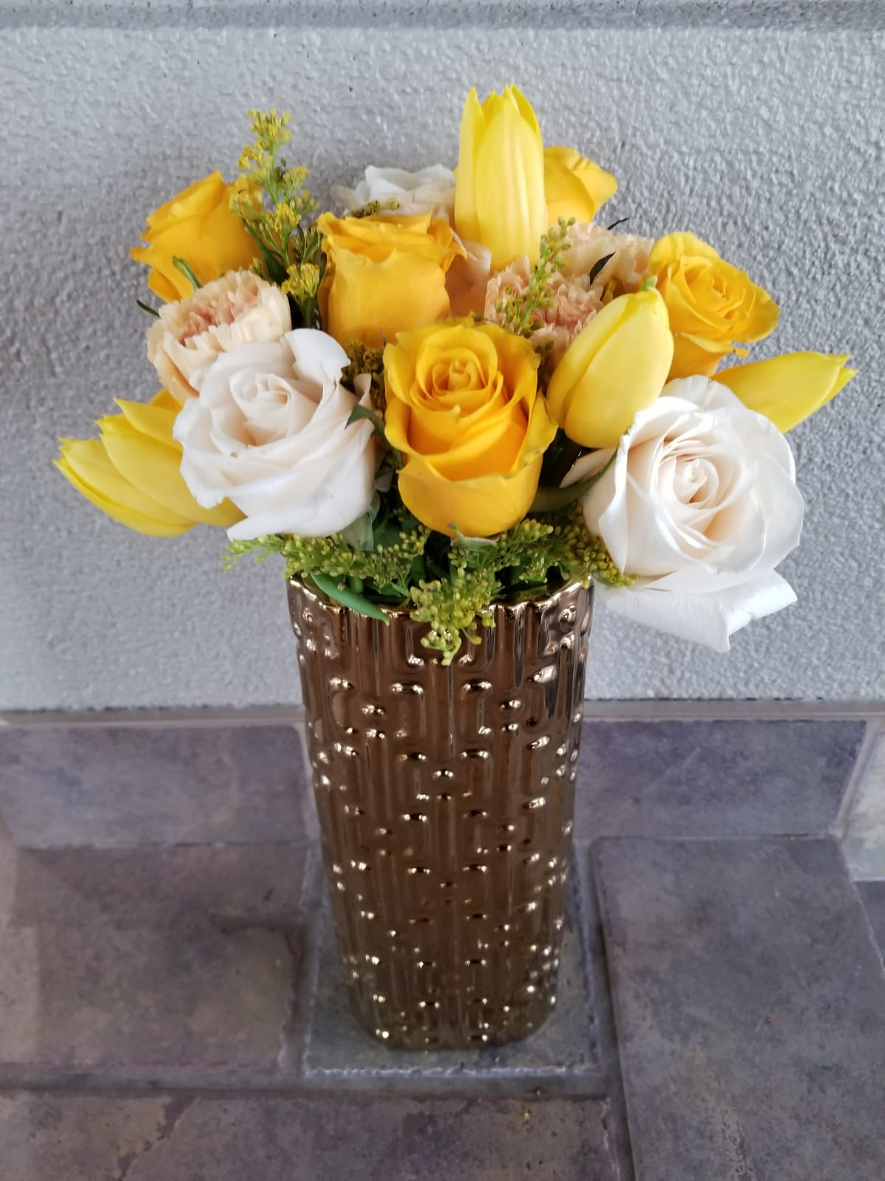

Slide 10
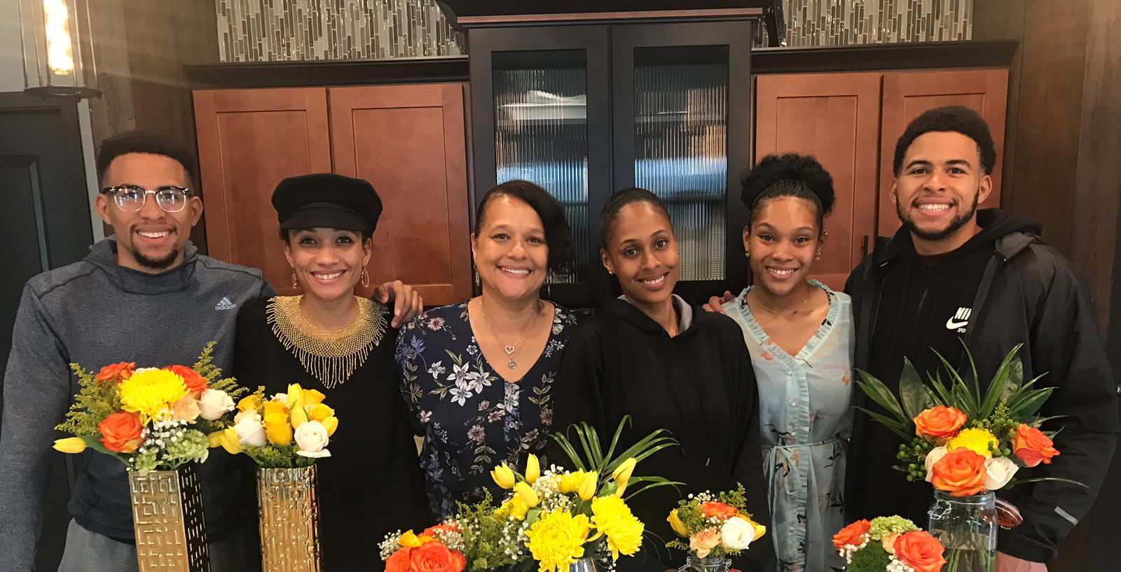
My Mother, Siblings, & I !

Slide 11
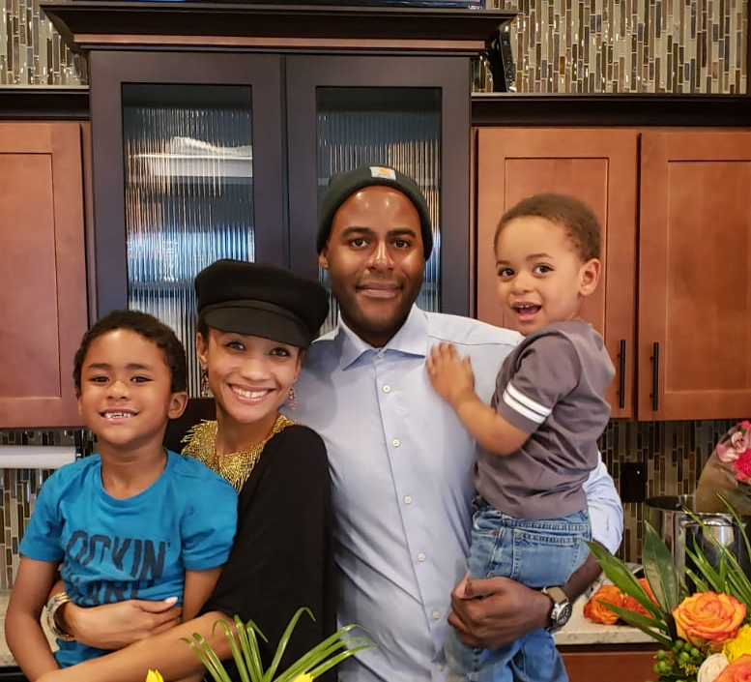
My Family & I
Joshua, my beloved, you are the greatest man I have ever known. Wise, gentle, and strong. Thank you for being a pusher and for encouraging me to step into the unknown.
I love you and appreciate the King that you are.
Caleb, my loving leader, you are such a caring creative soul. You eased me gently into motherhood.
Elijah, my bold boss, you have all the character traits on my bucket list. You entered our lives like a mighty wind and made me side-eye motherhood.

Slide 12
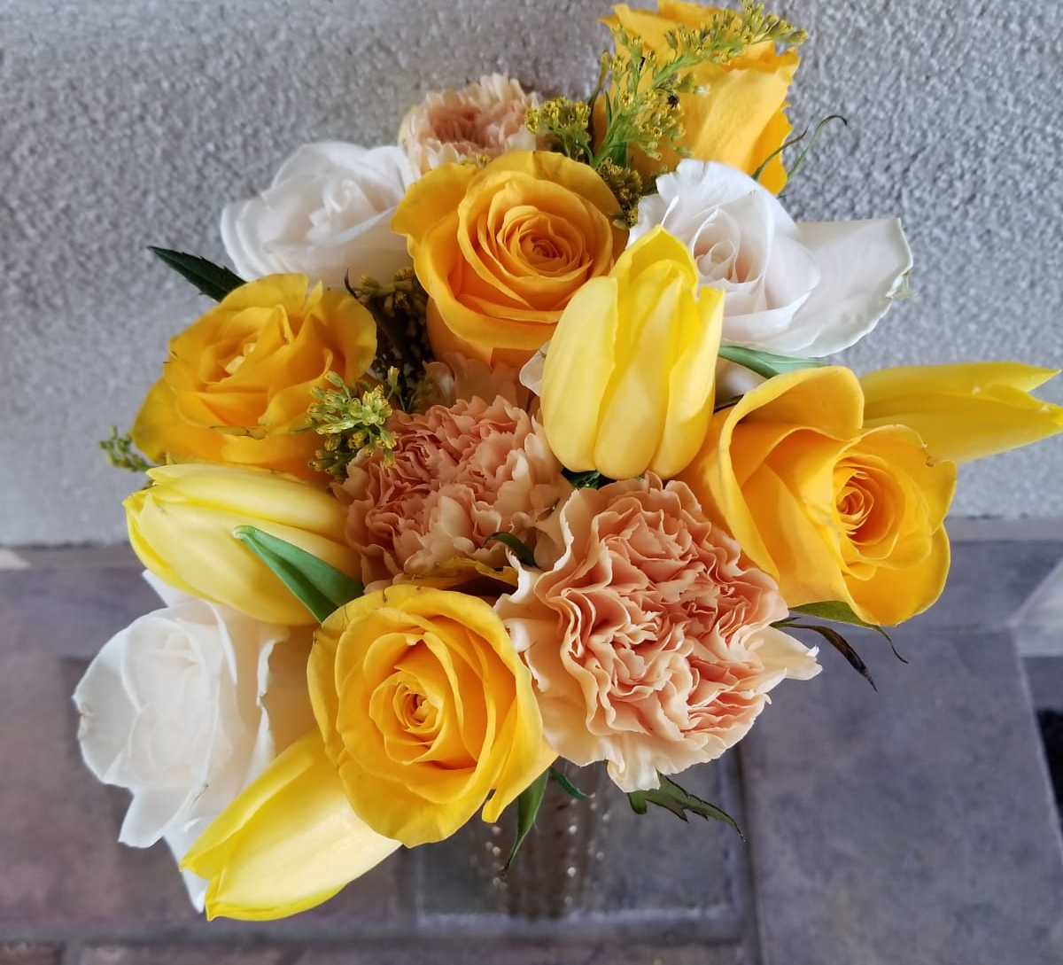




Thank you for viewing this e-scrapbook!
Lonisa Johnson
Lo Johnson
hello_mrs.lo
hellomrslo@gmail.com

